Slide 1

Introduction
Maria RAIDY
CSC326 - Operating Systems Laboratory
Fall 2018

Slide 2
What is Ubuntu?
A Linux-based operating system since 20 October 2004.
It is designed for computers, smartphones, and network servers.
The system is developed by a UK based company called Canonical Ltd.
All the principles used to develop the Ubuntu software are based on the principles of Open Source software development.
Named after the Southern African philosophy of ubuntu that can be loosely translated as "humanity to others" or "I am what I am because of who we all are".

Slide 3
Basic Concepts
A terminal is a "physical"(direct) interface to your Linux Operating System.
A shell is an interpreter for commands entered into the terminal.
The Bourne Again Shell (bash) is a popular shell on Linux systems.
A command is usually a small utility that the shell will execute for you.
Output is what a command returns; most often this is returned on the terminal.
Input consists of the arguments or data that any given command will take. Input will change the way a given command acts.
A process is a running application on your computer. It can be active, sleeping, or in a number of other states.

Slide 4
Why use the Terminal?
It can save you time.
It can help when you are unable to use the GUI, such as a system crash or a configuration issue.
It can enable you to use Linux in ways that using a GUI exclusively can not (such as scripting repetitive tasks).
Example:
You have been notified that you have used too much space.
You want to quickly work out where the most space is used:
Go to a command line and type: du | sort -n
You can try doing it via the GUI and check the speed difference.
Find out more by typing man intro in Terminal.
Check the date and time using cal and date
exit

Slide 5
Let’s get deeper!
Open Command Line (Terminal)
Try the directory listing command:
Syntax: ls –option directoryname
Examples: ls
ls –l (Lists the directory with more details)
ls --help (Lists all the options)
Get more info on this command using: man commandname
Exit the manual by pressing ‘q’
Clear the screen using: clear
Try the man --help command.
Notes:
Man runs an ls cmd
Press space to jump 1 screen.
Always use man for more info!

Slide 6
System Information Commands
The df command displays filesystem disk space usage for all mounted partitions:
"df -h" uses megabytes (M) and gigabytes (G)
What does h mean?
The du command displays the disk usage for a directory.
The free command displays the amount of free and used memory in the system. "free -m" will give the information using ??.
The top ('table of processes') command displays information on your Linux system, running processes and system resources, including CPU, RAM & swap usage and total number of tasks being run.
It is usually updated every 5sec OR by pressing space →
Notes:
H = human readable

Slide 7
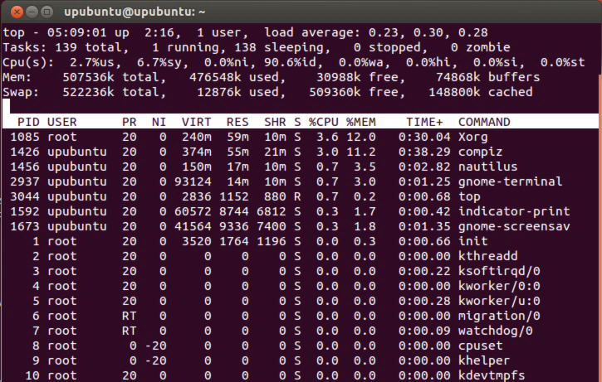
CPU usage
Priority
Command Name or Command Line You toggle between them with 'c
Resident Memory Size
Memory usage
Nice Value
Process ID
Real time scheduling priority
Priority will not be adjusted
Notes:
http://manpages.ubuntu.com/manpages/trusty/man1/top.1.html
NI -- Nice Value The nice value of the task. A negative nice value means higher priority, whereas a positive nice value means lower priority. Zero in this field simply means priority will not be adjusted in determining a task's dispatch-ability.

Slide 8
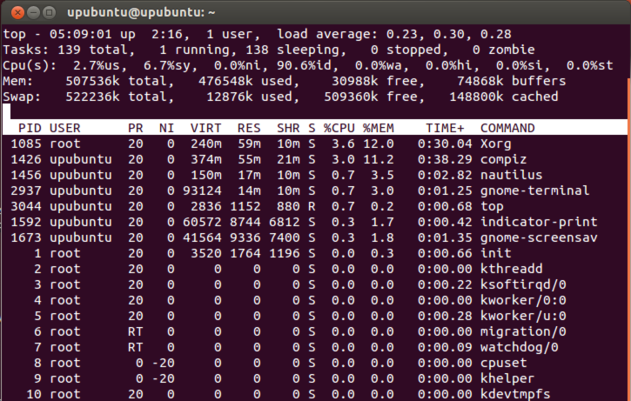
Process Status The status of the task which can be one of:
D = uninterruptible sleep R = running S = sleeping
T = traced or stopped Z = zombie
CPU time since start in 100th of sec
Virtual Memory Size (KiB)
Shared Memory Size (KiB)
To exit top, press "q".
Notes:
TIME -- CPU Time Total CPU time the task has used since it started. When 'Cumulative mode' is On, each process is listed with the cpu time that it and its dead children have used. You toggle 'Cumulative mode' with 'S', which is both a command-line option and an interactive command. See the 'S' interactive command for additional information regarding this mode.
TIME+ -- CPU Time, hundredths The same as 'TIME', but reflecting more granularity through hundredths of a second.
VIRT -- Virtual Memory Size (KiB) The total amount of virtual memory used by the task.

Slide 9
Multiple commands are allowed
To execute 2 commands consecutively:
command1 ; command2
To execute command 1 successfully before executing command2:
command1 && command2
To execute command2 only if command1 fails:
command1 || command2

Slide 10
Wildcards “?”, “*”, “[x-y]“ and “!”
Create a folder containing:
file1.pdf, file2.pdf, file2.mp3 and file23.pdf
List.txt lost.txt and last.txt
Specifying a single character once: ‘?’
Ex: ls file?.pdf will return file1.pdf and file2.pdf
Specifying multiple characters: ‘*’
Ex: ls file2.* will return file2.pdf and file2.mp3
Specifying a range: [x-y] → only 1 character
Ex: ls file[2-23].pdf will return file2.pdf and file23.pdf
Ex: ls file[0-9][0-9].pdf will return file1.pdf, file2.pdf and file23.pdf
Ex: ls l[aeiou]st.txt what will it return?
Negating a Set of Characters: [!x-y]
Ex: ls file[!0-2].*

Slide 11
Brace expansion (Bash feature)
Brace expansion (alternation) generates a set of alternative combinations.
! Generated results must not exist as files.
! The results of each expanded string are not sorted and left to right order is preserved.
Try:
$ echo a{p,c,d,b}e
$ echo {a,b,c}{d,e,f}
$ echo {a{b,{c,d}}}
$ echo {a{b{c,d}}}
+ Echo the expansions png, jpeg and jpg using braces expansion. (Hint, you can use braces in braces)
$ marks the start of a command
Notes:
echo *.{png,jp{e,}g}

Slide 12
Brace expansion (Bash feature)
Sequential ranges between 2 integers or characters separated by double dots:
Ex: $ echo {1..10}
$ echo file{1..4}.txt
$ echo {a..e}
Try: $ echo {a..m..2}
$ echo {9..20..3}
What does the 3rd integer specify?

Slide 13
Now, try these commands
whoami to know the identity of the user
pwd to know in which directory you’re located
cd ~/Desktop to change directories ( ‘cd ~’ home directory)
mkdir csc326 to create a directory called “csc326”
Search for csc326 in GUI and create a file in it called filetest.txt *
You can create a file directly from the terminal using the touch command
cd ~/Desktop/csc326
cp filetest.txt filecopy.txt to make a copy of filetest
find filecopy.txt
ls file*.txt
rm filetest.txt && rm filecopy.txt to delete the files
rmdir csc326 to delete the empty directory “csc326”
clear or ctrl+l
Notes:
* You can use the touch cmd to create a file directly from the terminal
Try the gedit filetest.txt to edit the file

Slide 14
To stop a running command
Ctrl +c
Ctrl +z
Notes:
* You can use the touch cmd to create a file directly from the terminal
Try the gedit filetest.txt to edit the file

Slide 15
Control Flow
We can redirect input and output to and from a command.
To write the output of a command in a file:
Command > filename Ex: ls > fileCf.txt && cat fileCF.txt
To write the output of a command in a file without deleting its initial content:
Command >> filename Ex: ls >> fileCf.txt && cat fileCF.txt
To take the input from a file for the command to be executed:
Command < filename Ex: sort < fileCf.txt
To use the output of command1 as input for command2:
Command1 | command2 Ex: ls | sort

Slide 16
Arithmetic
echo $((20+5))
expr 20 + 5
echo “20+5”
echo “20+5” | bc
Only 3 of these give the right result 25, which three?
Do you know any other ways?
Notes:
Bc can calculate very complex expression with roots, log, cos, sin,..

Slide 17
Comments and quoting
Try the following commands 1 by 1:
echo abc def
echo ‘abc def’
echo “abc def”
echo ‘abc “def”’
echo “abc ‘def’”
# echo ‘abc def’
What do you notice?

Slide 18
Aliases
The alias command makes it possible to launch any command or group of commands (inclusive of any options, arguments and redirection) by entering a pre-set string.
Try:
alias
Syntax:
alias [option] [name="value"] $ unalias [option] name(s)
Example:
$ alias p="pwd“
$ p
$ alias p="pwd“; alias ls="ls -a" $ unalias p
Why are aliases useful?
Notes:
Less typing
Specifying default options
Correcting common misspellings of cmds ex: pdw
Increases the safety of the system by making commands interactive. This forces the user to confirm that it is desired to perform a specific action and thereby reduces the risk from accidental or impulsive abuse of powerful commands. alias rm="rm -i"

Slide 19
Variables
Variable’s name can contain only letters, numbers and _ and should start with a letter
You can define read only variables, so once you create them, you cant change their value
Example:
$ a=foo (no space!)
$ echo $a
Foo
$readonly a make it readonly until this shell terminates
$ a=abc → will return an error
What will echo a output?
What will echo ‘$a’ output?
What will echo “$a” output?

Slide 20
Variables
To delete a variable (unsetting it):
unset VAR
Static arrays:
Ex: $ books={biology physics chemistry csc}
To print a specific item at position 0: $ echo ${books[0]}
To dump the whole array: $ echo ${books[*]}
$ echo ${books[@]}

Slide 21
String functions
Length: ${#str}
Substring: ${str:3}
Replace: ${str//old/new}
More:
${str:-2} pull from back
${str:4:2} substring at 4, length 2 chars
${str#?} delete first char
${str%?} delete last char

Slide 22
Conditionals
Let’s start with an example:
$ read –p “Enter your name: ” name → the read cmd allows the user to input a value
Enter your name: Maria
$ if [[ $name = $USER ]]; then
> echo "Hello, me."
> else
> echo "Hello, $name."
> fi
Hello, Maria.
To get multiple inputs from the user:
read –p “enter your full name: “ first last

Slide 23
The if statement
Syntax:
if list [ ;|<newline> ] then list ;|<newline> [
elif list [ ;|<newline> ] then list ;|<newline> ] ... [
else list ;|<newline> ]
fi
Ex:
if mv hello.txt ~/.Trash/; then echo "Moved hello.txt into the trash."
elif rm hello.txt; then echo "Deleted hello.txt."
else echo "Couldn't remove hello.txt.“; exit 1;
fi

Slide 24
Research and try these later:
if-then-else
case
Loops:
for
while
until
select

Slide 25
Creating your first bash script
Open a text file again using a text editor and add a hashbang to the top of it, as the first line of the script:
#!/usr/bin/env bash
Congratulations! You've created your first bash script.
It's a file with bash code in it that can be executed by the kernel just like any other program on your computer.
$ chmod +x hello.txt #Mark hello.txt as an executable program. →
$ ./hello.txt #Tell bash to start the hello.txt program.
Notes:
+x executable by everyone.

Slide 26
The chmod command
It stands for change mode
Syntax: chmod options permissions filename
If we have a file named file1.txt you can give some permissions (read, write, execute) to the user, the members of the group who owns the file and others: chmod u=rwx, g=rx, o=x file1.txt
Or using octal permissions notation: chmod 751 file1.txt
4 stands for read, 2 for write, 1 for execute and 0 for no permission. (8 unique combinations!)
The default permissions can be displayed by running the umask command
They can be modified using: umask u-x, g=r, o+w
Notes:
User cant execute
Gp can read but neither write nor execute
O can write (no changes to read and execute permissions)

Slide 27
Operators (to be used when needed)
Numerical Operators:
-eq: equal
-ne: not equal
-gt: greater than
-ge: greater than or equal
-lt: less than
-le: less than or equal
String Operators:
= : equality between strings
!=: inequality between strings
-z: true if string is empty
-n: true if string is not empty
Files Operators:
-e: check the existence of the resource
-f : check if the resource is a file
-d: check if the resource is a directory
-r: check if the resource is readable
-w: check if the resource is writeable
-x: check if the resource is executable
-s: check if the resource has a non-zero size
Logical Operators:
-a: logical and -o: logical or !: negation

Slide 28
expr
All-purpose expression evaluator: Concatenates and evaluates the arguments according to the operation given (arguments must be separated by spaces): ex:
expr 3 + 5
returns 8
expr 5 % 3
returns 2
expr 1 / 0
returns the error message, expr: division by zero
Illegal arithmetic operations not allowed.
expr 5 \* 3
returns 15
The multiplication operator must be escaped when used in an arithmetic expression with expr.
y=`expr $y + 1`
Increment a variable, with the same effect as let y=y+1 and y=$(($y+1)).
z=`expr substr $string $position $length`
Extract substring of $length characters, starting at $position.

Slide 29
http://www.tldp.org/LDP/abs/html/moreadv.html#EX45
Example 16-9. Using expr

Slide 30
Edit the text file:
#!/usr/bin/env bash
# Nested if statements
if [ $1 -gt 100 ]
then
echo Hey that\'s a large number.
if (( $1 % 2 == 0 ))
then
echo And is also an even number.
fi
fi

Slide 31
System and Administrative Commands
Special variables:
$$: get the process ID
$PPID: get parent ID
To list the current user and the groups he belongs to: groups
This corresponds to the $GROUPS internal variable, but gives the group names, rather than the numbers.
$ echo $GROUPS
To show all users logged on to the system: who
To give info about the current user: ?

Slide 32
System and Administrative Commands
ac: To show user logged in time
lastcomm: Gives information about previous commands, as stored in the /var/account/pacct file. Command name and user name can be specified by options:
Lsof: lists open files, info about owner, size, associated process.
Strace: diagnostic and debugging tool for tracing system calls and signals. Useful for diagnosing why a given program or package fails to run

Slide 33
Job Control
ps ax: Process Statistics: lists currently executing processes by owner and PID (process ID).
pgrep: combination of ps and grep (ex: $pgrep boo)
pstree: lists currently executing programs in tree format. (Ex pstree –p)
Pidof: identifies the process id of a running job.

Slide 34
1) Write a shell script to ask your name, program name and enrollment number and print it on the screen.

Slide 35
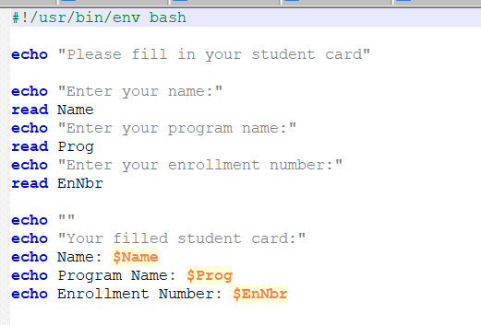
1) Write a shell script to ask your name, program name and enrollment number and print it on the screen.

Slide 36
2) Write a shell script to find the sum, the average and the product of the four integers entered

Slide 37
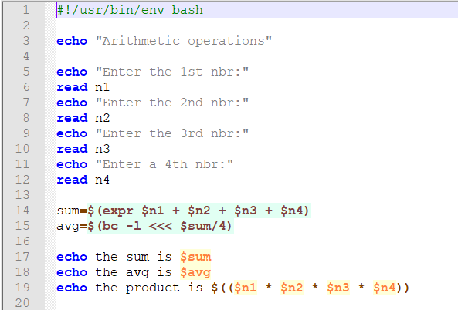
2) Write a shell script to find the sum, the average and the product of the four integers entered

Slide 38
3) Write a shell program to exchange the values of two variables

Slide 39
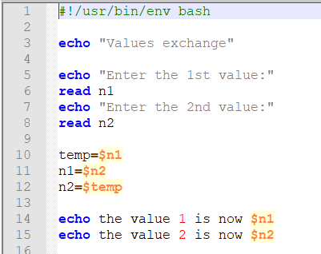
3) Write a shell program to exchange the values of two variables

Slide 40
4) Write a shell script to display the digits which are in odd position in a given 5 digit number

Slide 41
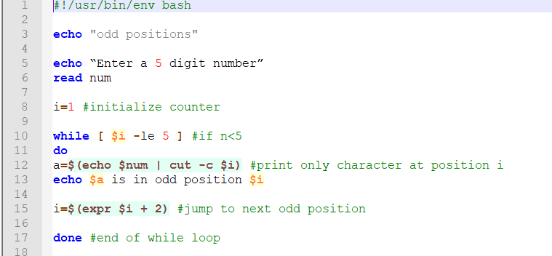
4) Write a shell script to display the digits which are in odd position in a given 5 digit number

Slide 42
5) Write a shell program to reverse the digits of five digit integer

Slide 43
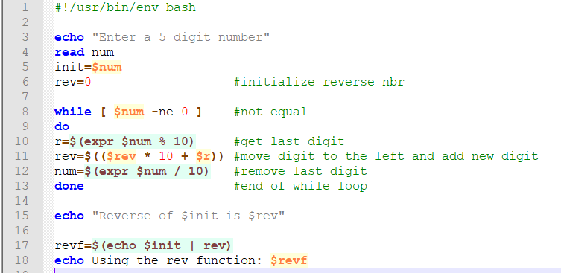
5) Write a shell program to reverse the digits of five digit integer

Slide 44
6) Write a shell program to add, subtract and multiply the 2 given numbers passed as command line arguments

Slide 45
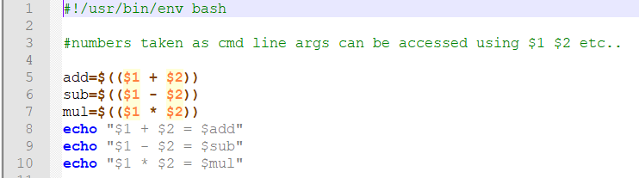
6) Write a shell program to add, subtract and multiply the 2 given numbers passed as command line arguments

Slide 46
We’re done for today!
Run the shutdown command.

Slide 47
For next session
Test some commands
Assignment
Conditionals

Slide 48
More info on:
https://www.tutorialspoint.com/ubuntu/ubuntu_overview.htm
https://wiki.ubuntu.com/RootSudo?highlight=%28sudo%29
https://help.ubuntu.com/community/CommandlineHowto
https://help.ubuntu.com/community/UsingTheTerminal?action=show&redirect=BasicCommands
https://help.ubuntu.com/community/AdvancedCommandlineHowto
http://searchdatacenter.techtarget.com/tutorial/77-Linux-commands-and-utilities-youll-actually-use
http://www.linfo.org/alias.html
http://guide.bash.academy/
http://manpages.ubuntu.com/manpages/trusty/man1/top.1.html
http://www.tldp.org/LDP/abs/html/system.html job control
CSC326 - Operating Systems Laboratory
Fall 2017

